Slide 1
Divide-and-Conquer Determinization of Büchi automata
Yong Li
Joint work with Andrea Turrini, Weizhi Feng,
Moshe Y. Vardi and Lijun Zhang

Slide 2
Büchi determinization
Büchi automata are not closed under determinization
Deterministic ω-automata
Rabin (DRA)
Parity (DPA)
Emerson-Lei (DELA)
Nondeterministic Büchi automata (NBA)

Slide 3
Why Büchi determinization is important
Reactive synthesis
Probabilistic verification
Complementing NBA
Checking language inclusion of NBAs
Notes:
Pecan proving results on Sturmian words

Slide 4

Existing constructions
Input NBA
SCC 1
SCC 2
Deterministic ω-automata
Rabin (DRA)
Parity (DPA)
$$⋮$$
SCC k
Safra-Piterman’s construction

Slide 5
Existing constructions
Input NBA
SCC 1
SCC 2
Deterministic ω-automata
Rabin (DRA)
Parity (DPA)
$$⋮$$
SCC k
Work on all SCCs at once

Slide 6
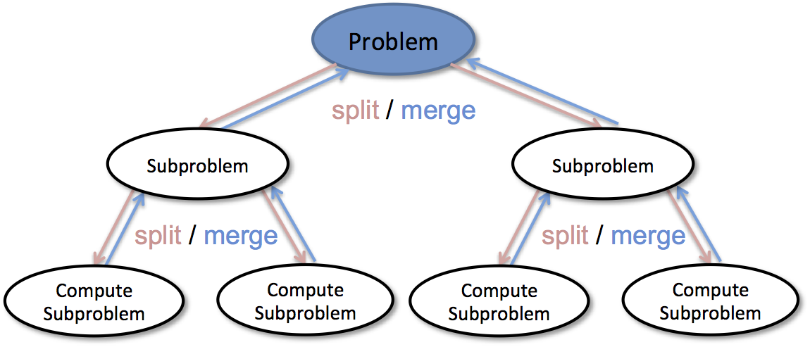
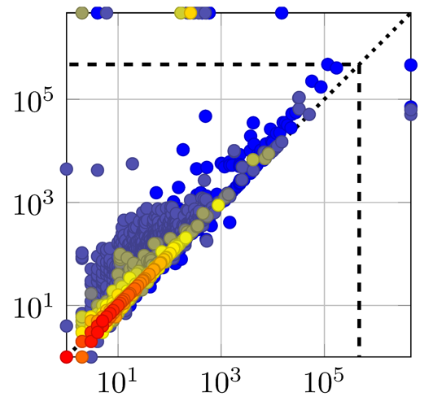



Our contributions
1. Divide-and-conquer methodology
2. Two subclasses
with better upper bounds
3. Comprehensive
evaluation
NBA: ${O((n!)}^{2})$
Class 1:$O(n!)$
Class 2:$O(2^{n})$

Slide 7



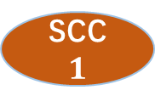

Our determinization construction
SCC $1$
DPA
1
SCC $2$
DPA
2
SCC
decomposition
Input NBA
$$A$$
Union product
$$⋮$$
DELA
$$⋮$$
SCC
K-1
DPA
k-1
SCC
k
DPA
k
Notes:
Convert to parity automata

Slide 8
Our determinization construction
SCC $1$
DPA
1
SCC $2$
DPA
2
Insight 1:
Determinize each SCC independently
SCC
decomposition
Input NBA
$$A$$
Union product
$$⋮$$
DELA
$$⋮$$
SCC
K-1
DPA
k-1
SCC
k
DPA
k
Notes:
Convert to parity automata

Slide 9
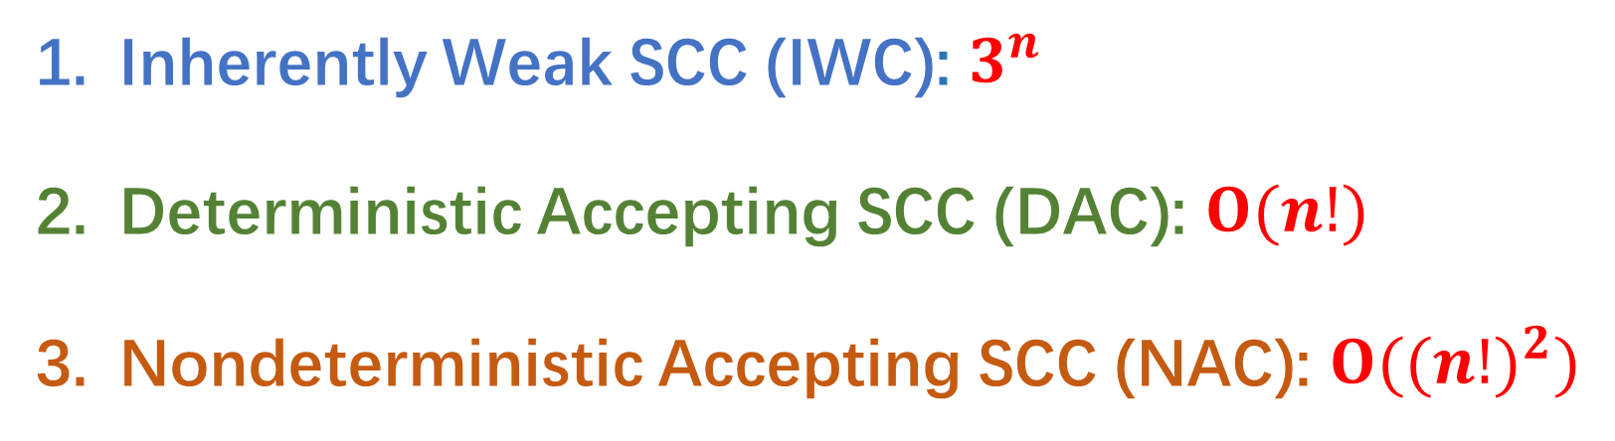
Determinizing different types of SCCs
Three different types of SCCs
Inherently Weak SCC (IWC): $3^{n}$
Deterministic Accepting SCC (DAC): $O(n!)$
Nondeterministic Accepting SCC (NAC): ${O((n!)}^{2})$

Slide 10
Determinizing different types of SCCs
Three different types of SCCs
Inherently Weak SCC (IWC): $3^{n}$
Deterministic Accepting SCC (DAC): $O(n!)$
Nondeterministic Accepting SCC (NAC): ${O((n!)}^{2})$
Insight 2:
Specific construction for each type of SCCs

Slide 11














Final determinization construction
IWC 1
IWC determinization
DPA 1
$$⋮$$
$$⋮$$
IWC $n_{w}$
DPA $n_{w}$
SCC
decomposition
DAC 1
DAC determinization
DPA 1
Union product
Input NBA
$$A$$
DELA
$$⋮$$
$$⋮$$
DAC $n_{d}$
DPA $n_{d}$
NAC determinization
NAC $1$
DPA $1$
$$⋮$$
$$⋮$$
NAC $n_{c}$
DPA $n_{c}$
Perform union product on-the-fly
Notes:
Convert to parity automata

Slide 12
Empirical evaluation
COLA solves more instances in shorter time
Tool | PAR-2 score: lower is better
COLA | 17,351
Spot | 67,258
Owl | 206,431
41
154
Notes:
Timeout: 10 mins for each instance

Slide 13
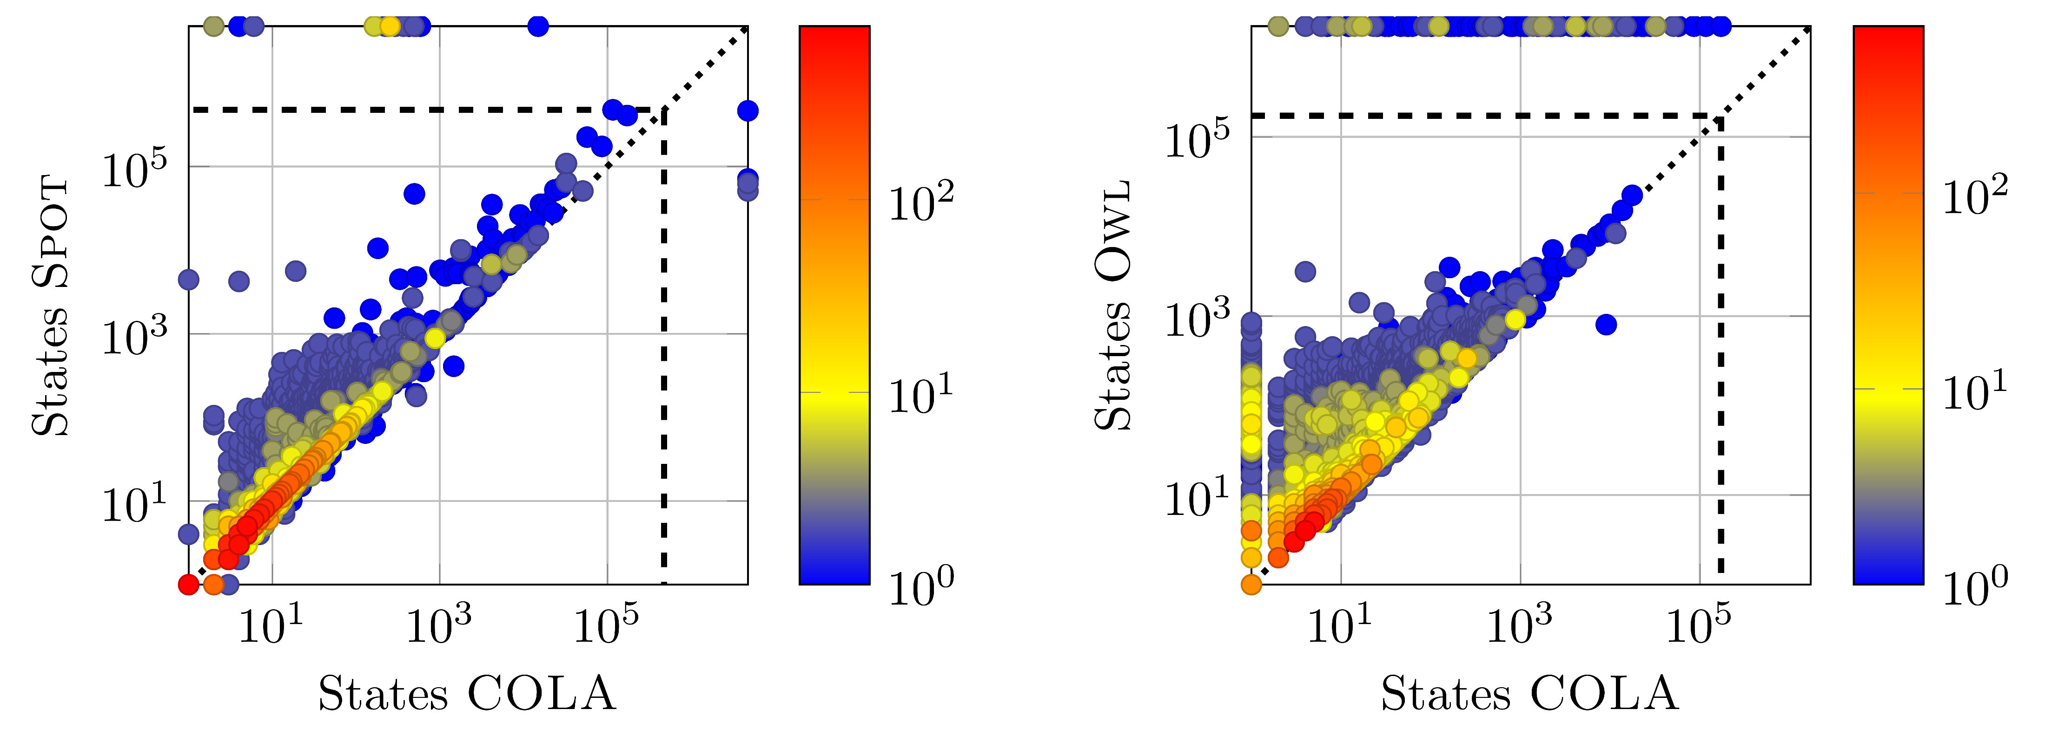
Comparison with Spot
Heat map: blue color corresponds to fewer data points
COLA constructs smaller
deterministic automata
than Spot

Slide 14
Comparison with Owl
Heat map: blue color corresponds to fewer data points
COLA constructs smaller
deterministic automata
than Owl

Slide 15
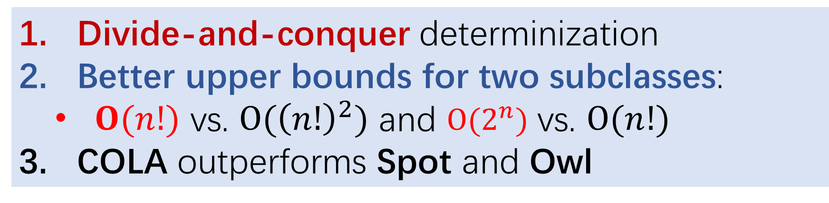
Summary
Divide-and-conquer determinization
Better upper bounds for two subclasses:
$O(n!)$ vs. $O({\left(n!\right)}^{2})$ and $O(2^{n})$ vs. $O(n!)$
COLA outperforms Spot and Owl
Future work
Parallel determinization for each SCC
Applications to
Reactive synthesis
Probabilistic verification
Büchi complementation and inclusion

